Slide 1
Chapter 2
Digital Design and Computer Architecture, 2nd Edition
David Money Harris and Sarah L. Harris

Slide 2
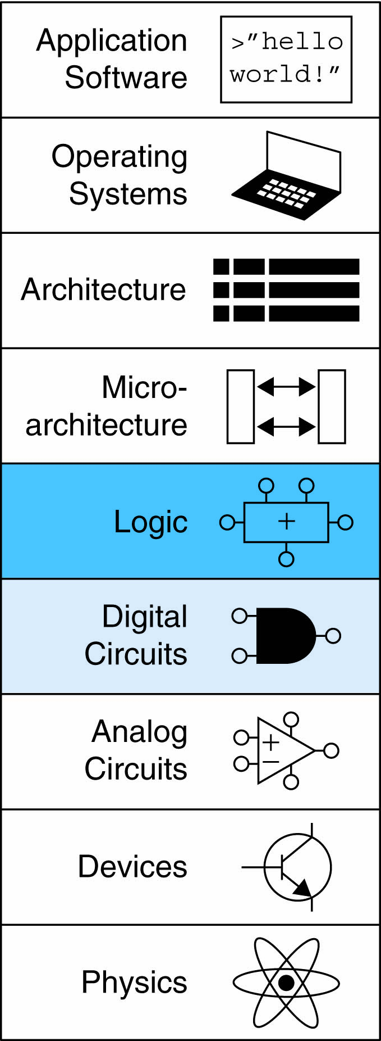
Chapter 2 :: Topics
Introduction
Boolean Equations
Boolean Algebra
From Logic to Gates
Multilevel Combinational Logic
X’s and Z’s, Oh My
Karnaugh Maps
Combinational Building Blocks
Timing

Slide 3
Introduction
A logic circuit is composed of:
Inputs
Outputs
Functional specification
Timing specification

Slide 4
Circuits
Nodes
Inputs: A, B, C
Outputs: Y, Z
Internal: n1
Circuit elements
E1, E2, E3
Each a circuit

Slide 5
Types of Logic Circuits
Combinational Logic
Memoryless
Outputs determined by current values of inputs
Sequential Logic
Has memory
Outputs determined by previous and current values of inputs

Slide 6
Rules of Combinational Composition
Every element is combinational
Every node is either an input or connects to exactly one output
The circuit contains no cyclic paths
Example:

Slide 7
Boolean Equations
Functional specification of outputs in terms of inputs
Example: Sum = F(A, B, C_{in})
C_{out} = F(A, B, C_{in})

Slide 8
Some Definitions
Complement: variable with a bar over it
A, B, C
Literal: variable or its complement
A, A, B, B, C, C
Implicant: product of literals
ABC, AC, BC
Minterm: product that includes all input variables
ABC, ABC, ABC
Maxterm: sum that includes all input variables
(A+B+C), (A+B+C), (A+B+C)
Notes:
Bar A = !A
Minterm is product
Maxterm is the or

Slide 9
Sum-of-Products (SOP) Form
All equations can be written in SOP form
Each row has a minterm
A minterm is a product (AND) of literals
Each minterm is TRUE for that row (and only that row)
Form function by ORing minterms where the output is TRUE
Thus, a sum (OR) of products (AND terms)
Y = F(A, B) =

Slide 10
Sum-of-Products Form
Sum-of-Products (SOP) Form
All equations can be written in SOP form
Each row has a minterm
A minterm is a product (AND) of literals
Each minterm is TRUE for that row (and only that row)
Form function by ORing minterms where the output is TRUE
Thus, a sum (OR) of products (AND terms)
Y = F(A, B) =

Slide 11
Sum-of-Products Form
Sum-of-Products (SOP) Form
All equations can be written in SOP form
Each row has a minterm
A minterm is a product (AND) of literals
Each minterm is TRUE for that row (and only that row)
Form function by ORing minterms where the output is TRUE
Thus, a sum (OR) of products (AND terms)
Y = F(A, B) = AB + AB = Σ(1, 3)

Slide 12
Product-of-Sums (POS) Form
All Boolean equations can be written in POS form
Each row has a maxterm
A maxterm is a sum (OR) of literals
Each maxterm is FALSE for that row (and only that row)
Form function by ANDing the maxterms for which the output is FALSE
Thus, a product (AND) of sums (OR terms)
Y = F(A, B) = (A + B)(A + B) = Π(0, 2)

Slide 13
Boolean Equations Example
You are going to the cafeteria for lunch
You won’t eat lunch (E)
If it’s not open (O) or
If they only serve corndogs (C)
Write a truth table for determining if you will eat lunch (E).

Slide 14
Boolean Equations Example
You are going to the cafeteria for lunch
You won’t eat lunch (E)
If it’s not open (O) or
If they only serve corndogs (C)
Write a truth table for determining if you will eat lunch (E).

Slide 15
SOP & POS Form
SOP – sum-of-products
POS – product-of-sums

Slide 16
SOP & POS Form
SOP – sum-of-products
POS – product-of-sums
E = OC
= Σ(2)
E = (O + C)(O + C)(O + C)
= Π(0, 1, 3)

Slide 17
Boolean Algebra
Axioms and theorems to simplify Boolean equations
Like regular algebra, but simpler: variables have only two values (1 or 0)
Duality in axioms and theorems:
ANDs and ORs, 0’s and 1’s interchanged

Slide 18
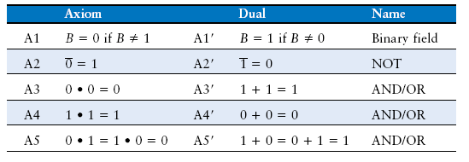
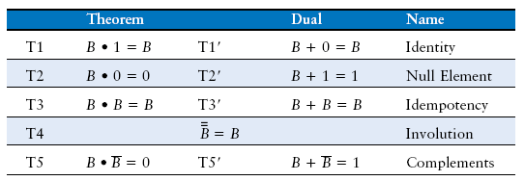
Boolean Axioms

Slide 19
T1: Identity Theorem
B 1 = B
B + 0 = B

Slide 20
T1: Identity Theorem
B 1 = B
B + 0 = B

Slide 21
T2: Null Element Theorem
B 0 = 0
B + 1 = 1

Slide 22
T2: Null Element Theorem
B 0 = 0
B + 1 = 1

Slide 23
T3: Idempotency Theorem
B B = B
B + B = B

Slide 24
T3: Idempotency Theorem
B B = B
B + B = B

Slide 25
T4: Identity Theorem
B = B

Slide 26
T4: Identity Theorem
B = B

Slide 27
T5: Complement Theorem
B B = 0
B + B = 1

Slide 28
T5: Complement Theorem
B B = 0
B + B = 1

Slide 29
Boolean Theorems Summary

Slide 30
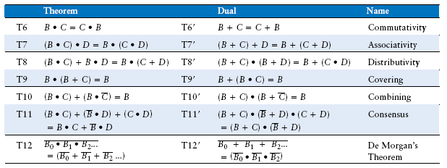
Boolean Theorems of Several Vars
(
)
Note: T8’ differs from traditional algebra: OR (+) distributes over AND (•)

Slide 31
Simplifying Boolean Equations
Example 1:
Y = AB + AB

Slide 32
Simplifying Boolean Equations
Example 1:
Y = AB + AB
= B(A + A) T8
= B(1) T5’
= B T1

Slide 33
Simplifying Boolean Equations
Example 2:
Y = A(AB + ABC)

Slide 34
Simplifying Boolean Equations
Example 2:
Y = A(AB + ABC)
= A(AB(1 + C)) T8
= A(AB(1)) T2’
= A(AB) T1
= (AA)B T7
= AB T3

Slide 35
DeMorgan’s Theorem
Y = AB = A + B
Y = A + B = A B

Slide 36
Bubble Pushing
Backward:
Body changes
Adds bubbles to inputs
Forward:
Body changes
Adds bubble to output

Slide 37
Bubble Pushing
What is the Boolean expression for this circuit?

Slide 38
Bubble Pushing
What is the Boolean expression for this circuit?
Y = AB + CD

Slide 39
Bubble Pushing Rules
Begin at output, then work toward inputs
Push bubbles on final output back
Draw gates in a form so bubbles cancel

Slide 40
Bubble Pushing Example

Slide 41
Bubble Pushing Example

Slide 42
Bubble Pushing Example

Slide 43
Bubble Pushing Example

Slide 44
From Logic to Gates
Two-level logic: ANDs followed by ORs
Example: Y = ABC + ABC + ABC

Slide 45
Circuit Schematics Rules
Inputs on the left (or top)
Outputs on right (or bottom)
Gates flow from left to right
Straight wires are best

Slide 46
Circuit Schematic Rules (cont.)
Wires always connect at a T junction
A dot where wires cross indicates a connection between the wires
Wires crossing without a dot make no connection

Slide 47
Multiple-Output Circuits
Example: Priority Circuit
Output asserted
corresponding to
most significant
TRUE input

Slide 48
Multiple-Output Circuits
Example: Priority Circuit
Output asserted
corresponding to
most significant
TRUE input

Slide 49
Priority Circuit Hardware

Slide 50
Don’t Cares

Slide 51
Contention: X
Contention: circuit tries to drive output to 1 and 0
Actual value somewhere in between
Could be 0, 1, or in forbidden zone
Might change with voltage, temperature, time, noise
Often causes excessive power dissipation
Warnings:
Contention usually indicates a bug.
X is used for “don’t care” and contention - look at the context to tell them apart

Slide 52
Floating: Z
Floating, high impedance, open, high Z
Floating output might be 0, 1, or somewhere in between
A voltmeter won’t indicate whether a node is floating
Tristate Buffer

Slide 53
Tristate Busses
Floating nodes are used in tristate busses
Many different drivers
Exactly one is active at
once

Slide 54
Karnaugh Maps (K-Maps)
Boolean expressions can be minimized by combining terms
K-maps minimize equations graphically
PA + PA = P

Slide 55
K-Map
Circle 1’s in adjacent squares
In Boolean expression, include only literals whose true and complement form are not in the circle
Y = AB

Slide 56
3-Input K-Map

Slide 57
3-Input K-Map
Y = AB + BC

Slide 58
K-Map Definitions
Complement: variable with a bar over it
A, B, C
Literal: variable or its complement
A, A, B, B, C, C
Implicant: product of literals
ABC, AC, BC
Prime implicant: implicant corresponding to the largest circle in a K-map

Slide 59
K-Map Rules
Every 1 must be circled at least once
Each circle must span a power of 2 (i.e. 1, 2, 4) squares in each direction
Each circle must be as large as possible
A circle may wrap around the edges
A “don't care” (X) is circled only if it helps minimize the equation

Slide 60
4-Input K-Map

Slide 61
4-Input K-Map

Slide 62
4-Input K-Map

Slide 63
K-Maps with Don’t Cares

Slide 64
K-Maps with Don’t Cares

Slide 65
K-Maps with Don’t Cares

Slide 66
Combinational Building Blocks
Multiplexers
Decoders

Slide 67
Multiplexer (Mux)
Selects between one of N inputs to connect to output
log₂N-bit select input – control input
Example: 2:1 Mux

Slide 68
Multiplexer Implementations
Logic gates
Sum-of-products form
Tristates
For an N-input mux, use N tristates
Turn on exactly one to select the appropriate input

Slide 69
Logic using Multiplexers
Using the mux as a lookup table

Slide 70
Logic using Multiplexers
Reducing the size of the mux

Slide 71
Decoders
N inputs, 2^{N} outputs
One-hot outputs: only one output HIGH at once

Slide 72
Decoder Implementation

Slide 73
Logic Using Decoders
OR minterms

Slide 74
Timing
Delay between input change and output changing
How to build fast circuits?

Slide 75
Propagation & Contamination Delay
Propagation delay: t_{pd} = max delay from input to output
Contamination delay: t_{cd} = min delay from input to output

Slide 76
Propagation & Contamination Delay
Delay is caused by
Capacitance and resistance in a circuit
Speed of light limitation
Reasons why t_{pd} and t_{cd} may be different:
Different rising and falling delays
Multiple inputs and outputs, some of which are faster than others
Circuits slow down when hot and speed up when cold

Slide 77
Critical (Long) & Short Paths
Critical (Long) Path: t_{pd} = 2t_{pd_AND} + t_{pd_OR}
Short Path: t_{cd} = t_{cd_AND}

Slide 78
Glitches
When a single input change causes an output to change multiple times

Slide 79
Glitch Example
What happens when A = 0, C = 1, B falls?

Slide 80
Glitch Example (cont.)

Slide 81
Fixing the Glitch

Slide 82
Why Understand Glitches?
Glitches don’t cause problems because of synchronous design conventions (see Chapter 3)
It’s important to recognize a glitch: in simulations or on oscilloscope
Can’t get rid of all glitches – simultaneous transitions on multiple inputs can also cause glitches

